Slide 1
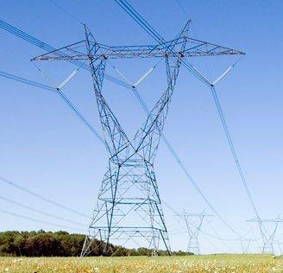
Electrical Power System Series
Measurement of Energy
By
Dino, BASc, M.Eng, P.Eng
© B. Porretta , October 2016
berardino.porretta@rogers.com

Slide 2
Energy and Human Activities
Energy permeates every aspect of human endeavor. For this reason, Energy is a very important commodity for commerce.
A fundamental prerequisite for commerce, is the ability to measure (quantify) what is being bought or sold. This has provided a strong motivation for developing methods for measuring Energy.

Slide 3
Fundamental Concepts
Energy is a concept created by physicists to quantify that “something” that is required in nature to do things such as boiling water, turning a wheel, lifting a book, moving a rock, and so on.
The model for measuring Energy is based on the following concepts:
1. Energy is the ability for doing Work.
2. Work is done upon an object if a Force acting on it causes it to be displaced.
3. Intuitively, a Force is a push or pull on an object. In physics it is given body by Newton’s second law of motion that states :
F = ma
Using the MKS (metric) system of measurement:
F = Force measured in Newtons (N)
m = Mass measured in Kilograms (Kg)
a = acceleration in Meter per Second squared (M/S²)
Accordingly, a Newton has the dimensions of Kg M / S²

Slide 4
Measurement of Energy
Joule (J)
The metric unit for measuring Energy is the Joule named in honor of English physicist James Prescott Joule (Dec 24, 1818 – Oct 11, 1889).
One Joule is equal to the energy expended in applying a force of one Newton through a distance of one Meter
The average acceleration on a mass due to the earth’s gravity is about 9.8 m/s² . Per Newton’s second law of motion, the force due to earth’s gravity on a mass of 1÷9.8 Kg (0.225 Lb) is (1÷9.8 )x(9.8)=1 Newton.

Slide 5
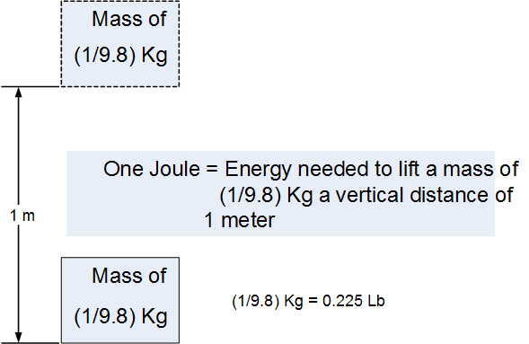
Visualizing the Joule
The following diagram provides a sense of how much energy a Joule is

Slide 7
Measurement of Energy
Food Calorie (Cal)
Before the Joule (J), there was the Calorie (cal). Today the Calorie
remains in use to measure food energy.
1 cal = energy to raise the temperature of 1 gm of water
1⁰ Celsius. This is about 4.184 J
1 Food Calorie (Cal) = 1000 cal = 4184 J
One small apple, about 30 calories (Cal), provides energy for lifting and lowering a mass of 22.5 Lb, to a height of 1 meter, approximately 600 times

Slide 8
Measurement Energy
British Thermal Unit (BTU)
1 BTU = 1,055.056 Joules
One BTU is the amount of energy required to raise the temperature of 1 pound (0.454 kg) of water by 1 °F (0.556 °C) .
Today, in North America, the BTU remains in use to measure the energy content of fuels, and to describe the output capacity of heating and cooling systems
The MBTU unit is equal to one thousand BTU, from the Roman numeral system where “M” stands for one thousand . This is easily confused with the metric (SI) system where the “M” means one million. Engineers use MMBTU to mean one million BTU.

Slide 9
Measurement of Energy
therm and decatherm
A therm (thm) is used to represent 100,000 BTU, and a decatherm (Dth) to mean one million BTU.
One therm is, approximately, the energy obtained from burning 100 cubic feet of natural gas.

Slide 10
Measurement of Energy
Ton
1 Ton = 12000 BTU/Hr
Ton (of Refrigeration) = Amount of power required to melt a
ShortTon (2000 Lb) of ice in 24 hours
Energy in a Ton = (12000 BTU/Hr) x 24Hr = 288,000 BTU
= 303,856,085 Joules

Slide 11
Measurement of Electric Energy
So far we have discussed the Joule. The definition of this unit of energy measurement is somewhat easier to appreciate because it relates to energy that derives from physical behavior of objects that we have had the opportunity to observe in our daily activities.
To gain a similar appreciation of how the Joule relates to electric energy, we need to dwell into the physical behavior of very “tiny” things that make up atoms.

Slide 12
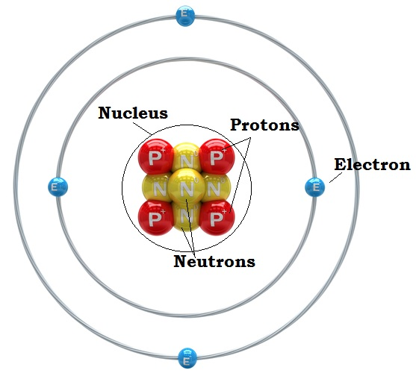
The Atom
  Matter is composed of small particles called atoms. For any element, the atom is the smallest quantity of that element that retains the identity of the element. The currently accepted model of an atom is shown below. The nucleus is made up by protons and neutrons. Protons have one positive charge while neutrons have no charge. Orbiting the nucleus, there are the Electrons, each having one negative charge, and held in orbit by electromagnetic forces. The number of protons is the same as the number of electrons to balance the charge of the atom.

Slide 13
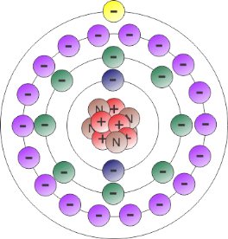
The Copper Atom ₂₉Cu⁶⁴
The outer orbit of the copper atom contains only one electron. The force that holds this electron in its orbit is very weak and, as a result, when not subject to external forces, this electron wanders randomly from atom to atom. Elements that have electrons that behave in this manner are called “conductors”

Slide 14
Measurement of Electrical Charges
Coulomb (C)
The charge of electrons is negative, and the electron is used to represent the smallest unit of electrical charge, namely, the “electron charge” referred to with the symbol “e”.
e = 1.6021765 × 10⁻¹⁹ C
or
1 C = 6.24151 × 10¹⁸ electrons

Slide 15
Review of the Sine and Cosine Functions
The discussion of the electromagnetic phenomena that
engineers have exploited to generate electricity requires
some basic understanding of the Sine and Cosine
functions.

Slide 16
Sine and Cosine Functions

Slide 17
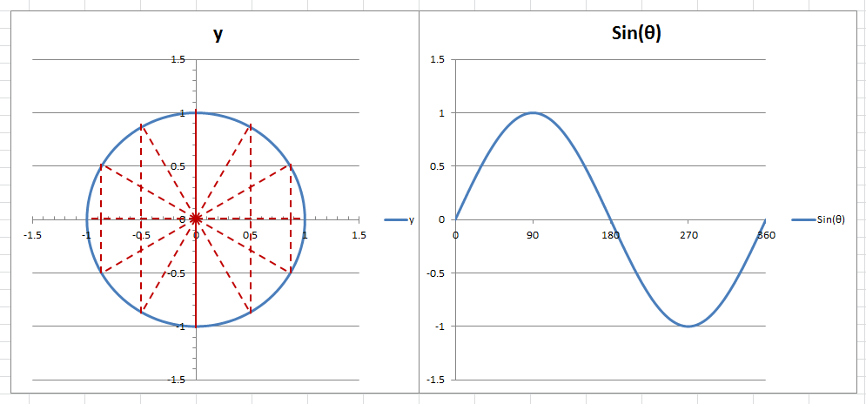
Value range of Sine and Cosine Functions
+ y
90
+
0
180
+x
θ
360
270

Slide 18
Practical Use of Sine and Cosine Functions

Slide 19
Potential Induced in a Conductor
Energy is required to maintain the electrical charge separation between terminals A and C. If it takes X Joules to create a charge separation of Y Coulombs, then we say that the electrical potential difference between A and C is (X/Y) Volt. So the Volt has the units of Joules/Coulomb .

Slide 20
Measurement of Electricity
Volt (V)
The Volt is the unit of measurement for Electric Potential ,or Voltage. The Voltage measures the capability of electricity to provide energy to do work on electrical charges. Named after Italian physicist Alessandro Volta (1745–1827).
The Voltage is always measured between two points. Thus it represents the electric potential difference between two points.
With reference the prior slide, the potential difference between points A and C is 1 Volt (V) if one Joule (J) of energy is needed to move 1 Coulomb (C) of negative charge from A to C.
1 V = 1 J/C

Slide 21
Current Induced in a Conductor
If a light bulb is connected across the voltmeter as shown, electrons will flow around the loop in the direction A to C due to the electric potential difference between A and C resulting from moving the conductor across the magnetic field. Engineers find the flow of positive charge more convenient. Accordingly, by convention, current flow is taken to be in the opposite direction of the electron flow.

Slide 22
Measurement of Electricity
Ampere (A)
The Ampere is the unit of measurement for electric current. It is named after Andre-Mary Ampere (1775–1836), french mathematician and physicist.
The ampere is a measure of the amount of electric charge passing a given point per unit of time.
1 A = 6.24151 × 10¹⁸ electrons passing a given point each second
or 1 A = 1 C/s

Slide 23
Measurement of Voltage and Current

Slide 24
Measurement of Electrical Power and Energy
Watt and Watt Second
Power represents the rate at which Energy is generated or consumed.
Therefore:
Power = Energy / Time
Energy = Power . Time
If a generator generates one Joule per each second, then the generator is generating 1 Watt (W).
The Watt was named to honor Scottish engineer James Watt (1736-1819).
1 Watt (W) = 1 Joule/Second (J/s)
1 Joule (J) = 1 Watt . Second (Ws)

Slide 25
Practical Units for Bulk Electricity Systems
MW and MWH
The Watt and the Watt-Second units are too small for bulk power system like the one that GSOC operates. When dealing with large amount of power the more practical units used are:
1 MW = 1 Million Watt
1 MWH = 1 Million Watt . Hour = 3600 Million Watt . Second
If a generator generates 1 MW continuously for 1 hour, the energy generated is 1 MWH
If a load consumes 1 MW continuously for 1 hour, the energy consumed is 1 MWH

Slide 26
Voltage, Current, and Power
Let us see what we get by multiplying Voltage with Current
1 V x 1 A = 1 J/C x 1 C/s
= 1 J/s
= 1 W
= Electrical Power P in watts
Therefore: P = V x I Watt
This formula for power is always correct for instantaneous power. In practice, it is more useful to calculate average power. When calculating average power, the above formula remains correct for DC electricity but not for AC electricity.

Slide 27
Direct Current (DC)
If the flow of electrons flows steadily always in one direction, the resulting current is referred to as Direct Current, or DC current.
The voltage from a battery produces a Direct Current.

Slide 28
Alternating Current (AC)
If electrons in a conductor flow back and forth in periodic cycles, the resulting current is called “Alternating Current”. In North America, electric generators generate alternating currents that flow back and forth 60 times per second and a voltage that goes up and down at the same frequency. In technical terms, we say that the frequency of the current, and voltage, is 60 Cycles/s or 60 Hz (Hertz)
The Hz was named in honor of German physicist Heinrich Rudolf Hertz (1857 – 1894).

Slide 29
Analogy for Power and Energy
The Speedometer in a car measures Speed . The Odometer measure Distance travelled
Speed = Distance / Time (miles/Hr)
Distance = Speed . Time (miles)
Speed can be measured only instantaneously.
Distance can be measured only over a period of time.
Driver uses speed (Miles/Hr) to operate car. Distance (Miles) is used for “after the fact” analysis.
Power = Energy/ Time (J/S or W )
Energy = Power .Time (J or W-S)
Power can be measured only instantaneously
Energy can be measure only over a period of time
Operator uses Power (MW) to operate system. Energy is used for “after the fact” analysis.
Speed is analogous to Power. Distance is analogous to Energy

Slide 30
Measurement of Electricity
Summary
Volt (V) = Electrical potential difference across two electrical points. Measured in Joule/Coulomb (J/C)
Current (I) = Flow of electrons flowing through a reference point per second. Measured in Amperes (A) or Coulomb/Second (C/S)
Power (P) = Rate of electric energy use. Measured in Joule/Second (J/S), or Watts (W).
Energy (E) = Measured in Joules (J) or Watt.Second, if energy accumulated over one second, and in Watt.Hour, if energy accumulated over one hour.
Charge (C) = Represents the number of surplus or deficit electrons of a substance. Therefore, electrical charges are always a multiple of the charge on an electron (e). Measured in Coulombs (C), where a Coulomb is equal to the charge of 6.24151 × 10¹⁸ electrons.

