Slide 1
Frequency Response of Electrical Power Systems
The Unabridged Story in 18 Questions
Electrical Power Systems Engineering Series
© Berardino (Dino) Porretta
June 8, 2017

Slide 2
Table of Contents
What Is Frequency Response (FR)?
Why Is FR Important to Interconnections?
Why Is FR Important to Balancing Areas?
Where Does FR Come From?
Does Inertia Provide FR?
Is Load FR Always Beneficial?
Is Generation FR Always Beneficial?
When Does a System Have Beneficial Equipment FR?
Is a System that Has No Equipment FR Operable?
Is Governor FR the Same as Equipment FR?
How Is Governor FR Represented on an FR Diagram?
What Is the Impact of Higher Equipment FR?
What Is the Impact of Lower Equipment FR?
What Is the Impact of Higher Inertia?
What Is the Impact of Lower Inertia?
What Is the Impact of Higher Governor FR?
What Is the Impact of Lower Governor FR?
What Do Utilities Need to Do To Ensure Sufficient FR?

Slide 3
What Is Frequency Response?
Frequency Response (FR), measured in MW/Hz , is the MW change in the Generation-Load balance affected automatically by the power system itself due to frequency changes alone.
Example:
On May 12, 2012 at 3:30 PM the Eastern Interconnection was operating balanced at 60.021 Hz. Suddenly 1711 MW of generation tripped off line. After 18 seconds the frequency settled at 59.9488 Hz. Accordingly, a frequency change of 0.0722 Hz (60.021-59.948) resulted in the system FR to change the generation-load imbalance from -1711 MW to zero thus arresting the frequency decay. Expressed in MW/Hz FR was :
FR = 1711 / 0.0722 = 23698 MW/Hz
To be consistent with the convention that gives a positive sign to flows out of a Balancing Area, the FR has to be expressed as a negative number. Also, it is customary to express FR in per tenth of a Hz. Accordingly in this case the FR was:
FR = -2369.8 MW/0.1Hz

Slide 4
Why Is FR Important to Interconnections?
In the example on the prior slide, the arresting of the frequency decay at 59.948 Hz by the FR allowed time for AGC control to be deployed and initiate frequency restoration to 60 HZ. If the FR had not been there, or had not been sufficient, the frequency decay would have continued. This would have resulted in load shedding and, if load shed not enough or if not shed fast enough, would have resulted in frequency protection tripping of generators and, consequently, caused blackouts. Also, in this case the Eastern Interconnection suffered a significant frequency decline but it remained stable. The FR also contributed to this stability.
In other words, lower FR translates into more common frequency decline events, load shedding events, and blackouts events.

Slide 5
Why Is FR Important to Balancing Areas?
Each balancing area has a strong vested interest in ensuring that its FR remains high for the following main reasons:
The successful operation of a Balancing Area (BA) depends on adequate interconnection reliability and this depends critically on good Interconnection FR. The higher the FR the higher the reliability. As higher interconnection FR derives from higher FR from each of the BAs , each BA has a vested interest in making sure that its own FR is higher.
2. A higher FR facilitates meeting a BA frequency response responsibilities.
A higher FR is important to be able to meet the BA control performance standards
A higher FR leads to a higher AGC Frequency Bias . This reduces up and down loading of BA generators thus reducing economic losses and wear and tear. The current practice of using 1% of peak load for Frequency Bias should be discontinued because it does not reward/penalize the BAs that “bring to the table” better/worse FR.
A higher FR increases significantly the ability of a BA to continue operating reliably if it were to remain isolated from the interconnection following a disturbance.

Slide 6
Where Does FR Come From?
FR derives from the intrinsic frequency characteristics of power system equipment (Equipment FR) and from the Governors of the individual generators (Governor FR).
1. Equipment FR, also referred here as EFR, is deployed without delay immediately as soon as the frequency starts to change. Its magnitude is a result of equipment physics and design practices. EFR consists of Load FR and Generation FR.
2. Governor FR, also referred here as GFR, is deployed with a time delay of about 2 to 5 seconds after the frequency starts to change. This delay is due to governors dead bands and velocity limits. Its magnitude is a result of Droop settings and of generator loading practices. In the case of the disturbance in the example on the second slide, GFR started at about 4.25 seconds, was not fully deployed until about 18 seconds, and its magnitude was only about 12% of the system FR.
Since EFR is deployed without delay, it provides the “first line of defence”, together with Inertia, that buys time for GFR to arrive. During the first few seconds, only the EFR and the Inertia help to stabilize the system.

Slide 7
Does Inertia Provide FR ?
Inertia does not provide FR. It only determines how fast the frequency can change. Accordingly, a higher Inertia gives more time for the Governor FR to arrive before frequency gets below load shedding settings, but in no way contributes to the arresting of the frequency decay.
Inertia determines how much energy is released from the rotating masses (generators and motors) to keep supplying the load on the way to a new generation-load equilibrium at a lower frequency. The value of the lower frequency at which the new equilibrium is found is determined by the FR.

Slide 8
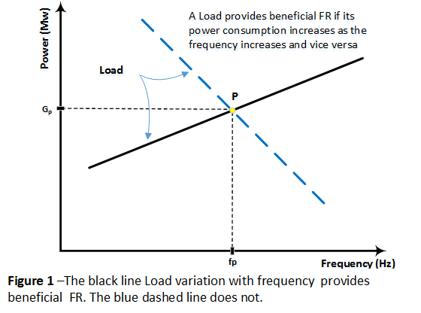
Is Load FR Always Beneficial?
The FR of the various loads are not all necessarily beneficial. To be beneficial the FR from a load must act to oppose the frequency change. If a load has beneficial FR its MW consumption versus Frequency plot, in the vicinity of 60 Hz and with the only parameter changing being the frequency, would be the black line shown below. A load with the load variation shown by the blue dashed line does not have beneficial FR. A flat line would indicate no FR at all. Although not all loads have beneficial FR , the evidence is that the FR from the aggregated system Load is beneficial.

Slide 9
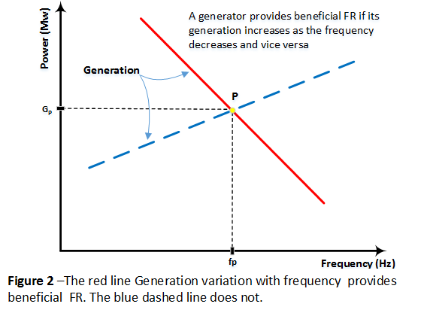
Is Generation FR always Beneficial?
The FR of the various generators are not all necessarily beneficial. To be beneficial the FR from a Generator must act to oppose the frequency change. If a generator has beneficial FR its MW generation versus Frequency plot, in the vicinity of 60 Hz and with the only parameter changing being the frequency, would be the red line shown below. A generator with the variation shown by the blue dashed line does not have beneficial FR. A flat line would indicate no FR at all. Although not all generators have beneficial FR the evidence is that the FR from the aggregated system Generation is beneficial.

Slide 10
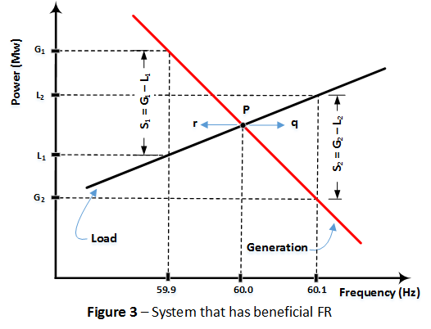
When Does a System Have Beneficial Equipment FR?
A system has beneficial EFR if the slope of the Generation Vs Frequency line is less than the slope of the Load Vs Frequency line.
In the system illustrated below, the system is operating balanced at point P. If the frequency were to be perturbed in the “r” direction, say to 59.9 Hz, the system would develop an FR of S1. As S1 is positive, the frequency will increase and the operation is pushed back to P. If the frequency were to be perturbed in the “q” direction, say to 60.1 Hz, the system would develop an FR of S2. As S2 is negative, the frequency will decrease and the operation is again pushed back to P. So such a System has beneficial EFR and it has , as a result, stable operating points such as point P.

Slide 11
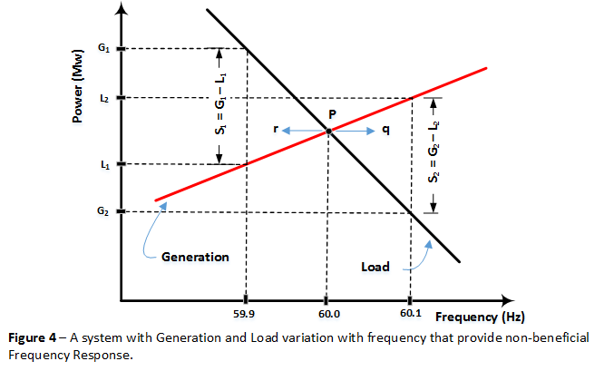
Can a System Without Beneficial Equipment FR Be Operated ?
The System illustrated below exhibits non-beneficial EFR. If the frequency is perturbed in the “q” direction, the system develops a positive imbalance S₂ and this keeps the frequency increasing away from operating point P. Similarly, a frequency perturbation in the “r” direction will develop a negative imbalance S₁ and this keeps the frequency decreasing away from P. Such a System has no stable operating points and would be impossible to operate reliably.

Slide 12
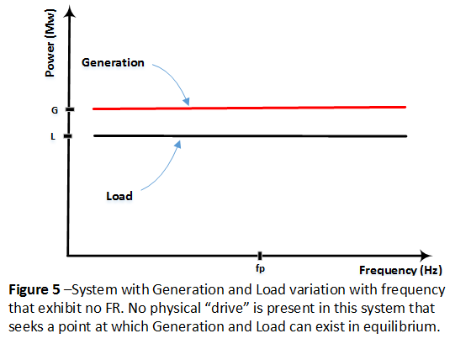
Can a System Without Equipment FR Be Operated ?
The System illustrated below has Generation and Load that exhibit no EFR. Since the Generation line is parallel to the Load line, this System has no operating points, namely, no intersection points at which Generation and Load can exist in equilibrium at some frequency. As a result, such a System would be impossible to operate. This is somewhat remindful of the need to introduce a Droop (a slope) for the stable operation of generator governors. As EFR is due to the physical characteristics of generators and loads it is not possible to add a “droop” if it is not there. In other words Governor response deficiencies can be correct with regulations, but EFR deficiencies cannot. Correcting EFR deficiencies would take years.

Slide 13
Is Governor FR the Same as Equipment FR?
Governor FR (GFR) is not the same as Equipment FR (EFR), although they both slow done the rate of frequency change and both contribute to arrest it. The differences are as follows:
1. EFR is always present as a constant contribution. Instead, GFR is zero for the first 2 to 5 seconds, then increases gradually, reaches its final contribution after 10 to 20 seconds, becomes zero again, and its magnitude depends on Droop settings and generation loading practices.
2. EFR can arrest the frequency decay but cannot reverse it. However, GFR, if sufficient, can reverse the frequency decay .
3. Both EFR and GFR cannot restore the frequency to 60 Hz because they are present only if the frequency is different than 60 Hz. Both contribute to restore the Generation-Load equilibrium albeit at a lower frequency. Frequency restoration has to wait for AGC control which changes loading set points of generators.
4. EFR represents the system damping, while GFR is the increase in generation due to an external automated generation rescheduling mechanism.
5. Deficiencies in GFR can be corrected quickly with regulations related to Droop settings and generation loading practices. EFR deficiencies can be corrected only by equipment replacement or changes and thus take years to correct.

Slide 14
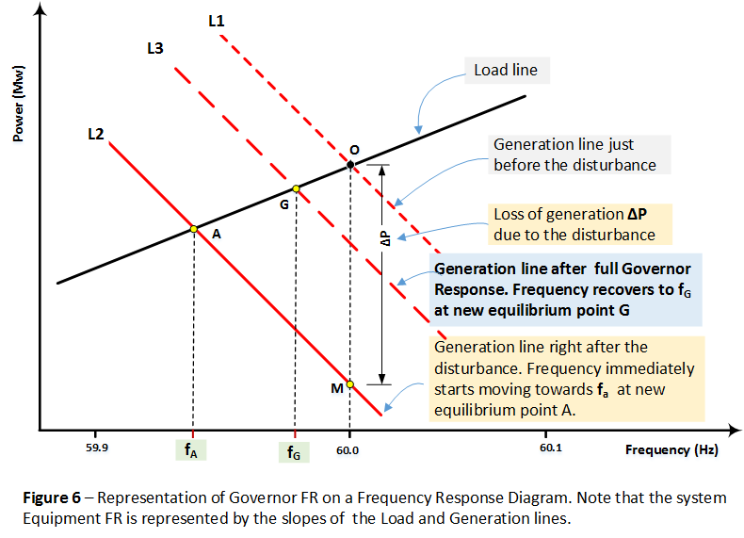
How Is Governor FR Represented on an FR Diagram ?
Governor FR is represented on an FR diagram by moving up the post-disturbance generation line (L2) by an amount equal to the additional MW generated due to Governors. In the illustration below, after governor response the post-disturbance line moves up to L3.

Slide 15
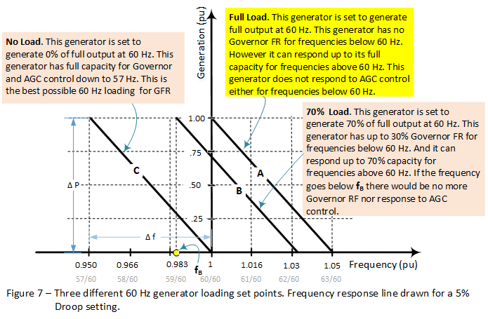
What Determines the Magnitude of Governor FR ?
The magnitude of a generator Governor FR depends on the generator 60 Hz loading set point and on the Droop of the governor. Droop, expressed as a percentage of reference frequency, is defined as the frequency change required to have the governor make the output of the generator go from zero to full output. It can be shown that the magnitude of the additional power Δ P which is generated due to governor response is given by Δ P = K*|Δ f| in pu of 60 Hz and of the generator capacity. K is related to 1/Droop. Focussing on situations where frequencies are below 60 Hz : (1) For generator C the K =1/0.05 = 20 for frequencies down to 57 Hz and it is zero below that. (2) For generator B the K is also 20 but for frequencies down to f_{B} Hz and is zero below that (3) For generator A the K is zero. In an interconnection which tends to consist of many generators loaded as A, B or C, the interconnection effective Droop can be significantly higher than 5% . Note that higher Droop means lower response.

Slide 16
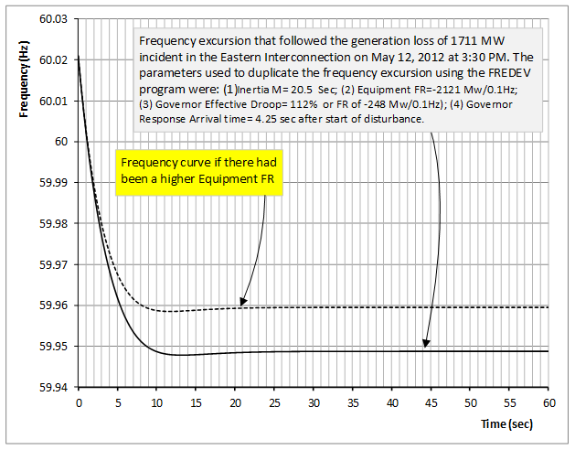
What Is the Impact of Higher Equipment FR?
A higher EFR slows down the rate of frequency decay (much like higher Inertia) and results in the arrest of the frequency decay at a higher frequency.

Slide 17
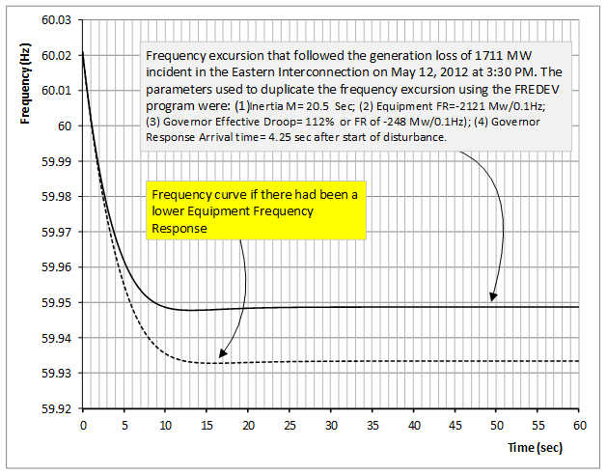
What Is the Impact of Lower Equipment FR?
A lower EFR increases the rate of frequency decay (much like lower Inertia) and results in the arrest of the frequency decay at a lower frequency.

Slide 18
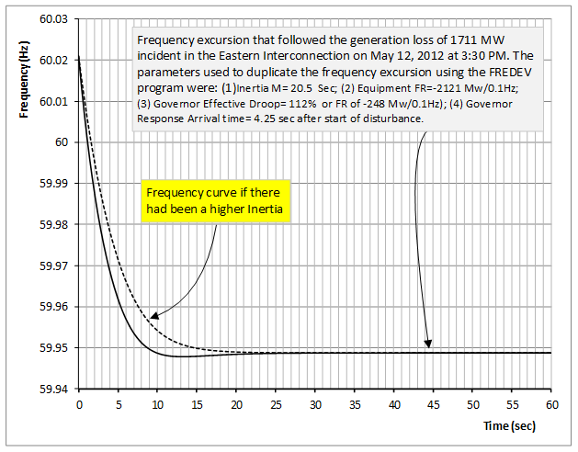
What Is the Impact of Higher Inertia?
A higher Inertia slows down the rate of frequency decay, much like higher EFR, but has no impact on the value of the frequency at which frequency decay is arrested.

Slide 19
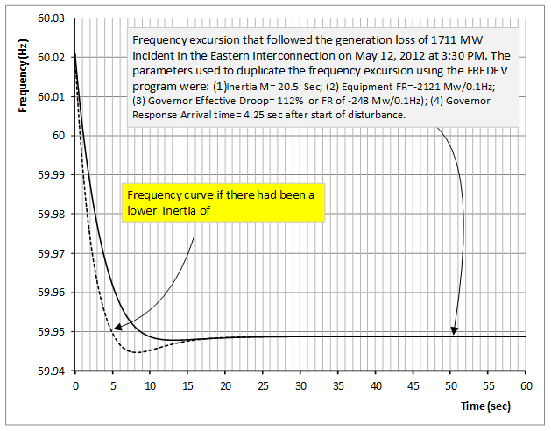
What Is the Impact of Lower Inertia?
A lower Inertia increases the rate of frequency decay, much like lower EFR, but has no impact the value of the frequency at which frequency decay is arrested.

Slide 20
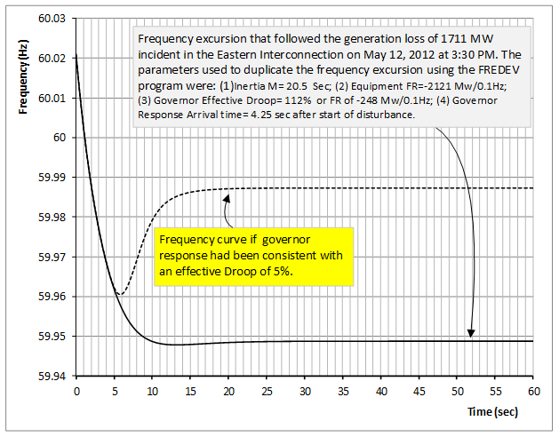
What Is the Impact of Higher Governor FR?
A higher Governor FR slows down the rate of frequency decay and , if sufficient as in this case, it can reverse the frequency decay. Also it will raise the value of the frequency at which the system frequency settles. This examples highlights the importance of sufficient Governor FR.

Slide 21
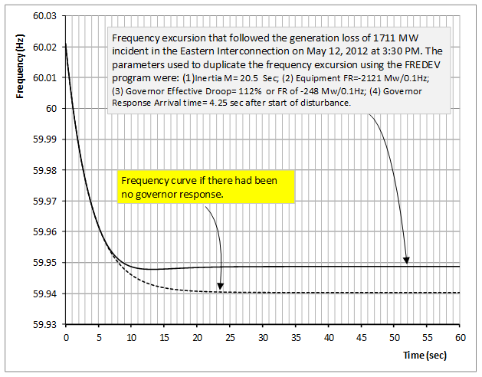
What Is the Impact of Lower Governor FR?
A lower Governor FR increases the rate of frequency decay and and it lowers the value of the frequency at which the system settles. This example confirms that the governor response for this incident was very poor as the final frequency with no governor response is not much lower than the one experienced.

Slide 22
What Do Utilities Need to Do To Ensure Sufficient FR?
Frequency Response and Inertia on our interconnections are declining due to emerging new generation technologies, new load supply technologies, and new types of loads. To ensure that sufficient Inertia and Frequency Response is maintained on our interconnections, utilities need to take the following initiatives:
Require new and existing generator to have adequate Inertia and Frequency response characteristics to be proven by tests. This is not unlike requiring generators to be able to operate to 0.85 power factor to ensure adequate voltage control.
Require all new and existing loads to have some minimum FR characteristics to be proven by tests. This is not unlike penalizing loads that have poor power factors.
Petition FERC to require NERC to initiate an ongoing study to determine by tests the FR and Inertia characteristics of Loads. This would provide a basis for determining which loads should be refused connection, penalized, or rewarded.
Petition FERC to require NERC to initiate an ongoing study to determine by tests the FR and Inertia characteristics of Generators. This would provide a basis for determining which generators should be refused connection, penalized, or rewarded.

Slide 23
The End
Electrical Power Systems Engineering Series
Berardino (Dino) Porretta
June 8, 2017

