Slide 1
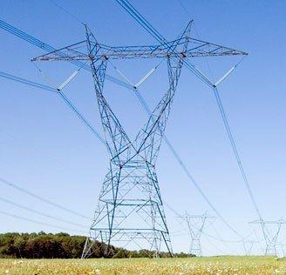
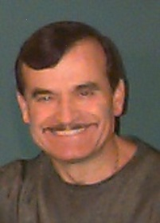
Energy Forms
and
Conversion to Electrical Energy
By
Dino, BASc, M.Eng, P.Eng
Electrical Power System Series
© B. Porretta , October 2016
berardino.porretta@rogers.com

Slide 2
Objective of Presentation
The objective of this presentation is to provide a general review of the various energy forms that we encounter in nature and the technologies in use to day to convert these energy forms to electricity.
The material is presented using simple terms without sacrificing conceptual correctness.
Electrical Energy Series
© B. Porretta, October 2016

Slide 3
What Is Energy ?
Changes in the chemical or physical state of anything in our environment requires a fundamental “something” that scientists have called Energy.
Examples of activities that need energy are:
- Heating your home
- Cooling your home
- Eating
- Moving your books
- Charging a battery
- Boiling water
All human activities involve use of energy in one form or another.
Electrical Energy Series
© B. Porretta, October 2016

Slide 4
Forms of Energy
Energy exists in six main forms, namely:
Mechanical: Energy stored in the motion or position of substances
Thermal: Energy stored in moving or vibrating molecules.
Chemical: Energy stored within the bonds of molecules.
Electrical: Energy stored in moving electrons.
Radiant: Energy stored in electromagnetic waves.
Nuclear: Energy stored in the bonds of atomic particles
Any of these forms of energy can be transformed into any of the other forms.
Electrical Energy Series
© B. Porretta, October 2016

Slide 5
Conservation of Energy
Energy can neither be created nor Destroyed
What this means is that when energy is used, it is not “used up”. It is simply changed from one form to another. The amount of energy present before and after its use is the same.
Electrical Energy Series
© B. Porretta, October 2016

Slide 6
Advantages of Electrical Energy
Some forms of energy are more convenient than others. Electrical energy has a number of advantages such as:
It can be transported in a convenient and cost effective way. This makes it practical to generate it at locations that are far away from the points of consumption. This allows convenient development of remote energy resources, and permits locating generating plants away from urban centers.
3. It can be converted conveniently and efficiently to the desired form of energy at the point of consumption.
4. Its use is clean.
5. It is fundamental to electronic technologies such as computers, cell phones, television, and so on.
Electrical Energy Series
© B. Porretta, October 2016

Slide 7
Electrical Energy Series
Conversion To and From Electrical Energy
The superior convenience of Electrical energy has provided strong
motivation to engineers to develop processes to:
1. Convert other forms of energy to Electrical energy for transportation to the customers.
2. Convert Electrical energy to other forms of energy for use by the customers
© B. Porretta, October 2016

Slide 8
Laws of Physics Used to Convert Other Forms of Energy to Electricity
Two phenomena of physics are utilized to day to generate electricity, namely:
Faraday Law of Electromagnetic Induction, discovered by English scientist Michael Faraday (1791-1867). About 99% of all electric energy generation in the USA is based on this law
Photovoltaic Effect , discovered in 1839 by French physicist A.E. Becquerel (1820-1891). About 1% of all electric energy generation in the USA is based on this effect.
Electrical Energy Series
© B. Porretta, October 2016

Slide 9
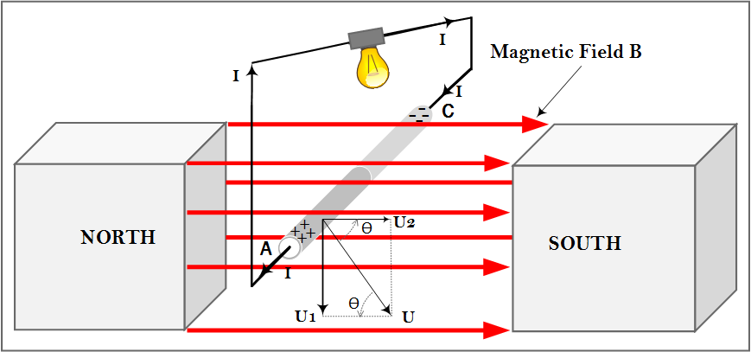
Faraday Law of Electromagnetic Induction If a conducting wire A-C is forced to move across a magnetic field “B” with velocity “U”, an electrical potential develops across the ends of the wire. If a conducting wire is used to connect the two ends to form a loop, a current “I” will flow. The higher the field “B”, the higher the velocity “U”, and the longer the wire that cuts the field, the higher the potential and, thus, the higher the current. Only the component of “U” that cuts the field at right angle (U1) contributes to the potential.
Electrical Energy Series
© B. Porretta, October 2016

Slide 10
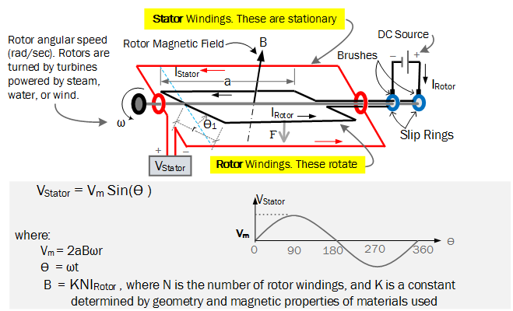
Faraday Law In Practice There are several arrangements used in practice to take advantage of Faraday Law to generate electricity. This sketch show the essentials of the arrangements. Rotor windings rotate, driven by turbines, inside stator windings to generate electricity. In the sketch, DC current is supplied to the rotor windings to generate the magnetic field “B”. Nuclear, fossil, and some solar plants, use steam to drive the turbines. Hydro plants use water. Wind plants use wind.
Electrical Energy Series
© B. Porretta, October 2016

Slide 11
Photovoltaic Effect The Photovoltaic Effect refers to the physical and chemical phenomena which result in an electric potential across some materials when light hits them. Most of the recent solar plant development in the USA is based on the Photovoltaic Effect. Some solar developments are more conventional as they use the sun to provide heat to create steam that then is used to turn turbines that drive the rotors of electrical generators based on Faraday Law of induction. An example is the Ivanpah Solar Power Facility in San Bernardino County, California. Solar plants, just as Wind plants, are the subject of much discussion these days as they provide power which is intermittent, and provide no support for frequency support. Because of this they pose serious threat to grid operating reliability. Both wind and solar plants also likely pose serious environmental impacts as they require a lot of land. For example, to replace a nuclear plant of 1000 Mw with solar, would require about 100 square miles of land. They may also cause dangerous shifts to our climate as the sunlight absorbed by the Solar Panels and the wind energy absorbed by the Wind Mills, becomes unavailable to our the ecosystems.
Electrical Energy Series
© B. Porretta, October 2016

Slide 12
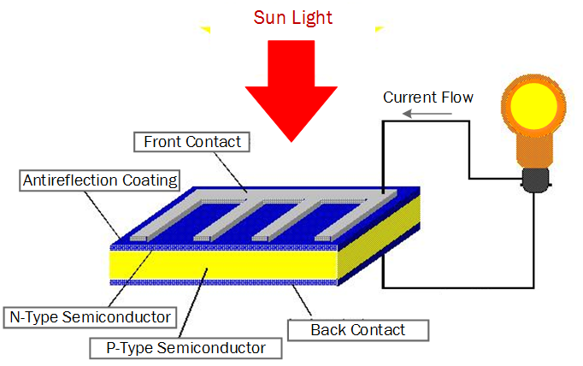
Electricity Generation Based on Photovoltaic Effect Recent developments use Solar Panels made of arrays of photovoltaic cells. As illustrated below, a typical cell is is made with N-Type and P-Type silicon wafers arranged as shown below. When the sun shines on the cell, this causes an electrical potential to develop across the front and back contacts. This potential causes a current to flows in a wire connected between the contacts.
Electrical Energy Series
© B. Porretta, October 2016

Slide 13
Examples of Energy Conversions to Electricity
At Plant Hatch, GA, nuclear energy is converted to Electricity
At Plant Scherer, GA, coal chemical energy is converted to Electricity
At Hoover Dam, NV, water mechanical energy is converted to Electricity
At Plant Smarr, GA, gas chemical energy is converted to Electricity
At Hartwell, GA, oil chemical energy is converted to Electricity
At Azalea, GA, the sun radiant energy is converted to Electricity
At Ashtabula, ND, wind mechanical energy is converted to Electricity
Electrical Energy Series
© B. Porretta

Slide 14
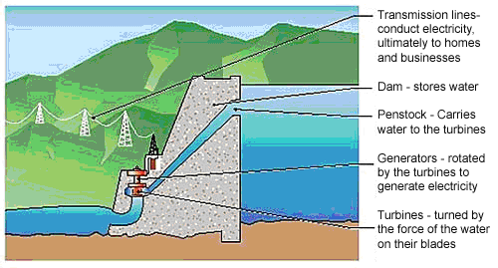
Electrical Energy Series
Hydraulic Power Plant
B. Porretta , Oct 2016

Slide 15
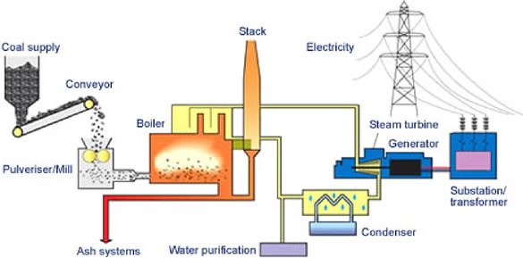
Electrical Energy Series
Coal Power Plant
B. Porretta , Oct 2016

Slide 16
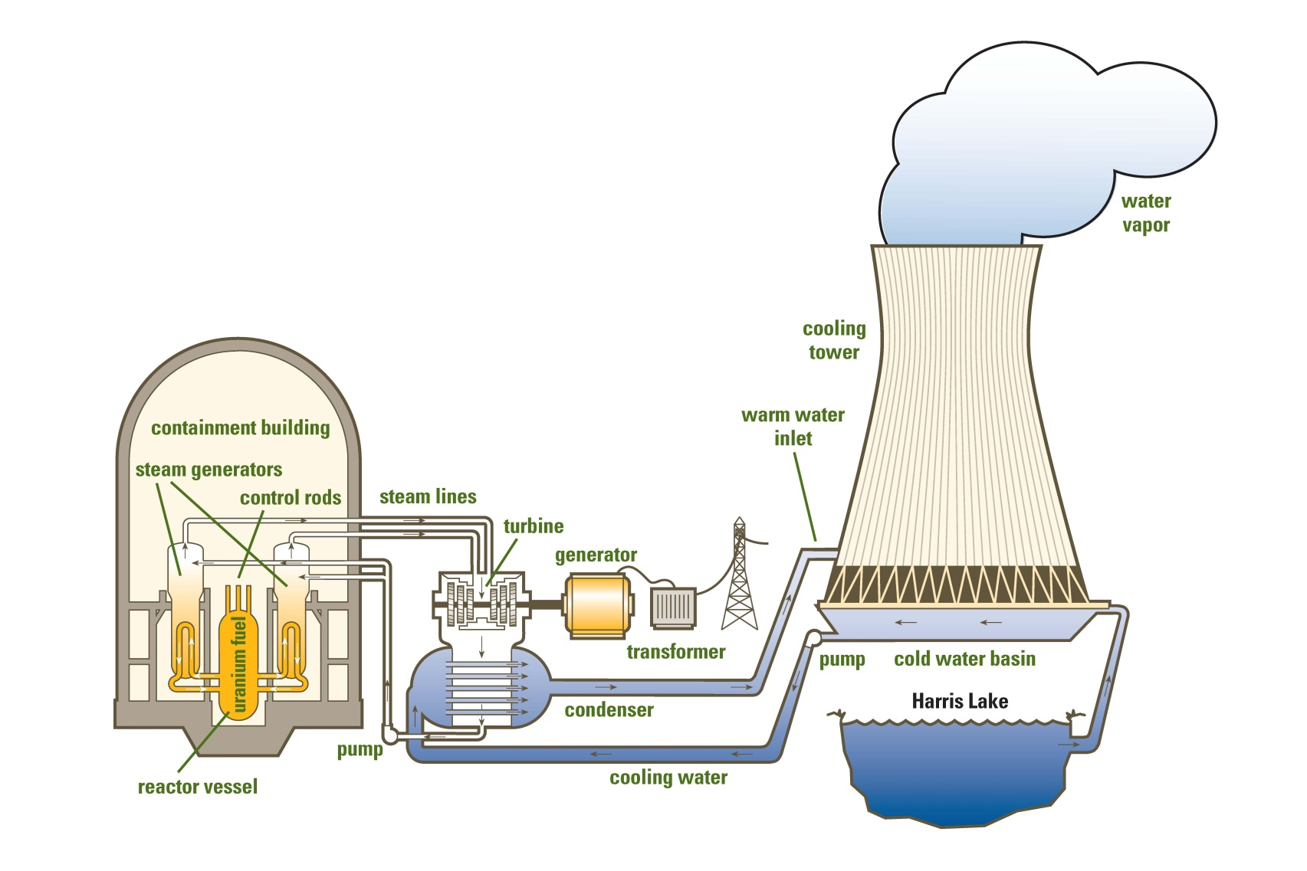
Electrical Energy Series
Nuclear Power Plant
B. Porretta , Oct 2016

Slide 17
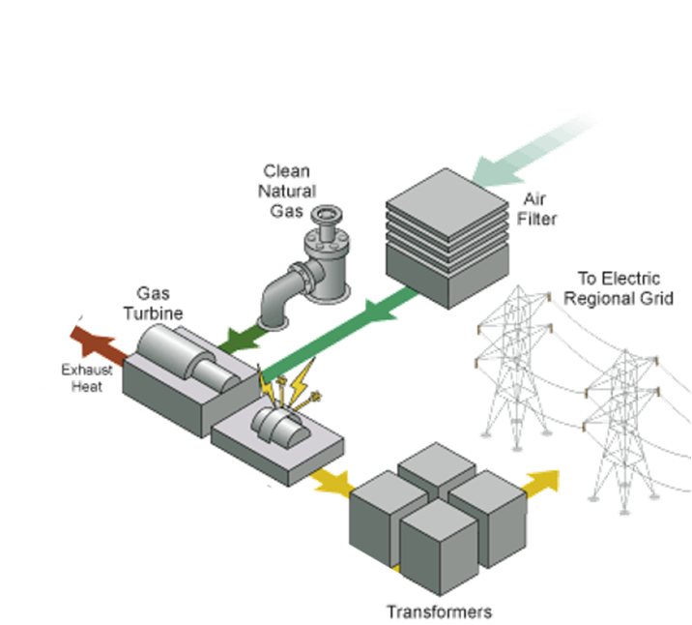
Electrical Energy Series
Open Cycle Combustion Turbine Plant
B. Porretta , Oct 2016

Slide 18
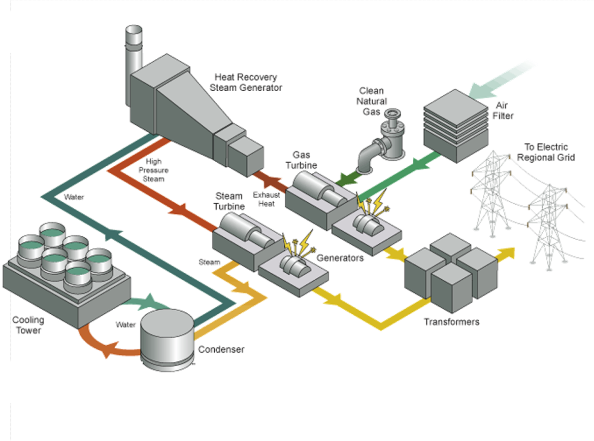
Electrical Energy Series
Combined Cycle Combustion Turbine Plant
B. Porretta , Oct 2016

Slide 19
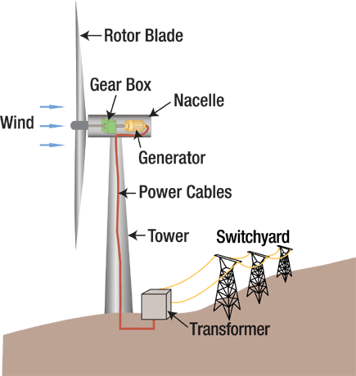
Wind Power Plant
Electrical Energy Series
B. Porretta , Oct 2016

Slide 20
Typical Conversion Efficiencies
Electrical Energy Series
 |  | Fuel | Efficiency
 |  | Hydro | 90%
 |  | Coal | 34%
 |  | Oil | 33%
 |  | Gas OC | 31%
 |  | Gas CC | 48%
 |  | Nuclear | 33%
 |  | Solar | 16.40%
 |  | Wind | 48%
 | According to Betz's law, no turbine can capture more than 59.3% of the kinetic energy in wind.
B. Porretta , Oct 2016

Slide 21
Electricity Conversion to Other Forms of Energy
For Customers
Light bulbs convert Electricity to Radiant energy.
Motors convert Electricity to Mechanical energy.
Baseboard heaters convert Electricity to Thermal energy.
Electrolysis of water converts Electricity to Chemical energy in the Hydrogen produced.
Cell phones convert Radiant energy to Electricity and Electricity to Radiant energy.
Electrical Energy Series
B. Porretta , Oct 2016

Slide 22
Typical Efficiencies of Electricity Usage
Use | Efficiency
Heating | 98%
Motors | 70% to 93%
Incandescent Lighting | 1.9%
Halogen Lighting | 3.5%
Fluorescent Lighting | 11%
LED Lighting | 23%

Slide 23
The End
Electrical Energy Series
B. Porretta , Oct 2016

