Slide 1
East Interconnection Generation Loss of 1711 MW on May 12, 2012 A Case Study to Present a Methodology to Calculate Inertia, Equipment Frequency Response, and Governor Response from Disturbance Data.
© Berardino (Dino) Porretta
June 9, 2017

Slide 2
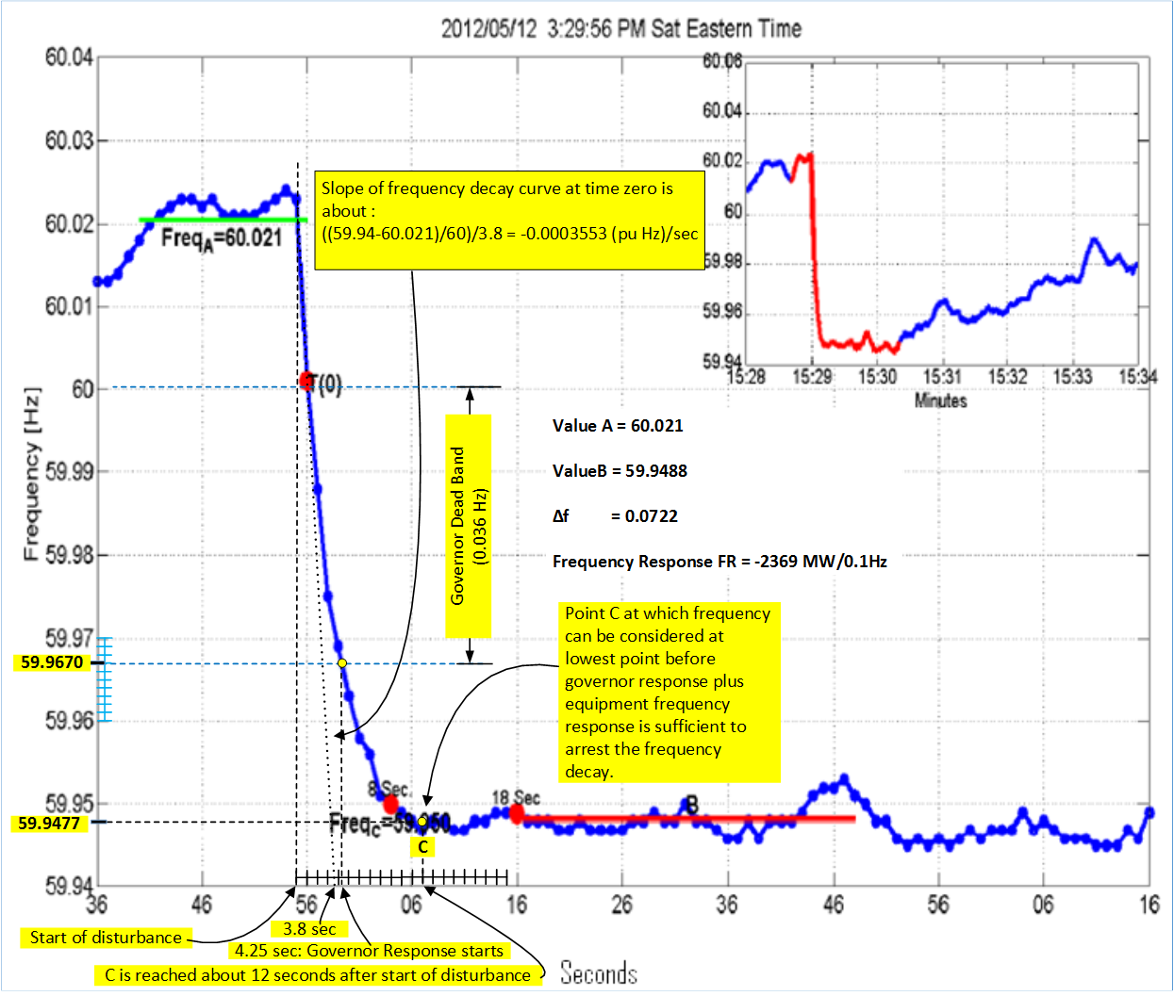
Figure 1 – Data for the May 12, 2012 Loss of 1711 MW of generation on the Eastern Interconnection. This data was obtained from NERC report "Frequency Response Initiative Report " dated October, 2012. The data highlighted in yellow was inserted for analysis purposes.

Slide 3
Results of Reconstruction Analysis
Figure 1 above, summarizes the data for the disturbance . The slope of the frequency curve at time zero is estimated graphically to be 0.0003553 pu Hz/sec. Since at time zero this slope is directly proportional to the generation loss and inversely proportional to the Inertia M, from this slope M is calculated to be 20.5 sec. Also, assuming that the governor dead band was 0.036 Hz, from the frequency decay curve it is established that governor response started at 4.25 seconds. As there was no governor response at 4.25 seconds, this point (t=4.25 sec, f=59.967 Hz) can be used to calculate the equipment frequency response (D). The calculations results in D=5.41 pu. Now that the M and D are known, the effective governor response can be established using the FREDEV program with different values of effective droops and various governors vs time response curves.
Figure 2 below, shows the frequency decay curve obtained with the FREDEV program, which duplicates the actual frequency decay curve that is shown in Figure 1 . The program obtained the curve using the following parameters:
Generation Loss = - 0.007275 in pu of generation left in service.
Inertia M = 20.5 seconds
Equipment Frequency Response = 5.41 pu
Effective Governors Droop = 112 % (NERC guidelines requires 3% to 5%)
Governor response start time = 4.25 sec. (after start of disturbance)
Governor response vs Time curve = See Figure 1a in next slide
The pu bases used in the program are: 60 Hz for the frequency; and Generation Left in Service (GLS) for the power. As the GLS was not available, its value was estimated by assuming that the system frequency response of -2369 Mw/0.1Hz was 1% of the load. For this reason, although expected to be generally representative, these results would need to be verified using actual data for the GLS value.
The system FR (frequency response), namely -2369 Mw/0.1Hz, expressed in pu is 6.04. Accordingly, in this case the FR from equipment was significantly higher (84%) than the FR from governor response (16%). The effective Droop calculated does in fact indicate that governor response was poor.

Slide 4
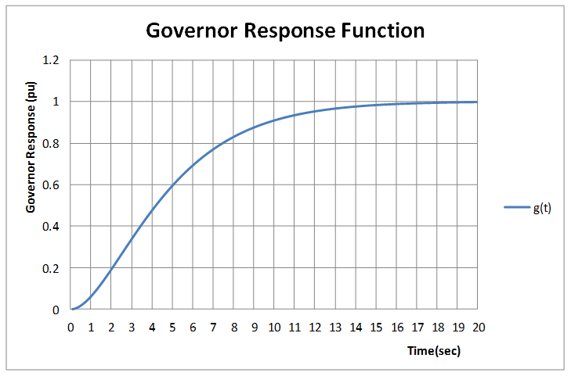
Figure 1a – The governor response was assumed critically damped. The amount of MW from governor response at time “t” was calculated as (1/Droop) g(t)

Slide 5
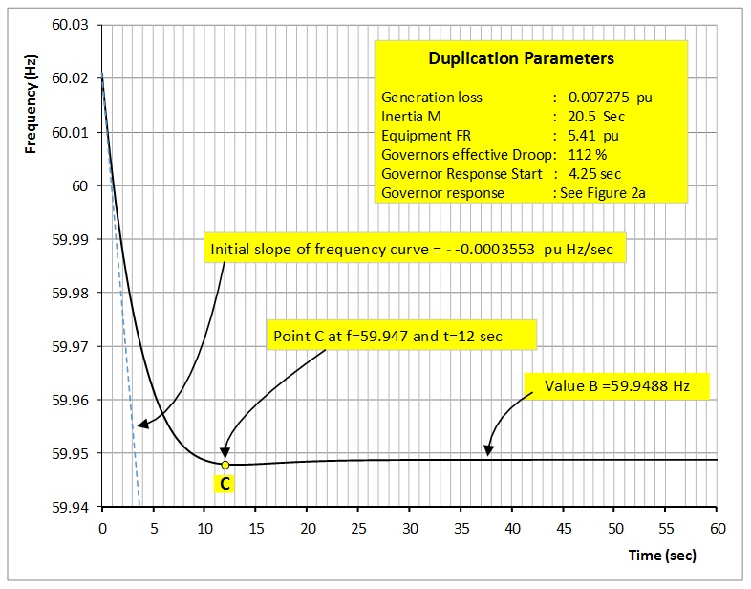
Figure 2 – Duplication of incident frequency excursion. The duplication parameters are in per unit of 60 Hz and of the generation left in service (GLS). As the GLS was not available, its value was estimated by assuming that the frequency response of - 2369 Mw/0.1Hz was 1% of the load. The GLS was estimated to be 235189 MW

Slide 6
“What If” Analysis
Figures 3 and 4 show the impact of less or more governor response respectively. Figure 4 illustrates the fact that Governor Response is key to arresting the frequency decay to a level that is not too low. If this incident is representative, then governor response on the Eastern Interconnection is much, much lower than the expected 3% to 5% Droop settings.
Figure 5 and 6 show the impact of less or more Inertia respectively. More inertia gives more time for controllers to act. However it has no impact on the ultimate frequency at the which the system comes to rest within the first 10 to 20 seconds following a disturbance. Inertial Response is very important to the ability of the system to recover from disturbances because it determines how fast system frequency system can change, but it is not Frequency Response.
Figure 7 and 8 show the impact of less or more Equipment Frequency Response (FR) respectively. Equipment FR impacts the frequency rate of change in a way similar to less or more Inertia. However, in addition, Equipment FR impacts significantly the ultimate frequency that the system would attain. This highlights the importance of Equipment FR which, in the “good old days”, was referred to as Self Regulation.

Slide 7
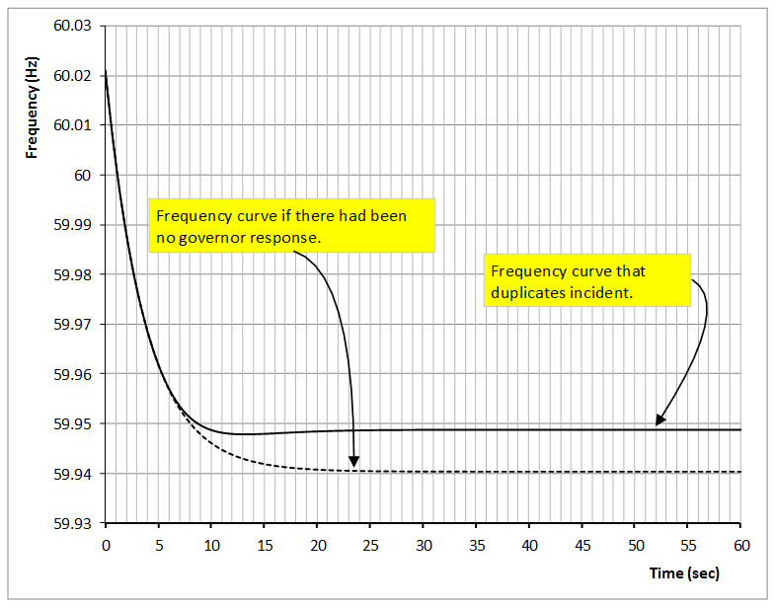
Figure 3 – What If there had been no governor response. In such case the frequency would have been arrested at 59.94 Hz or only 0.0088 Hz lower. This confirms that there had been little governor response.

Slide 8
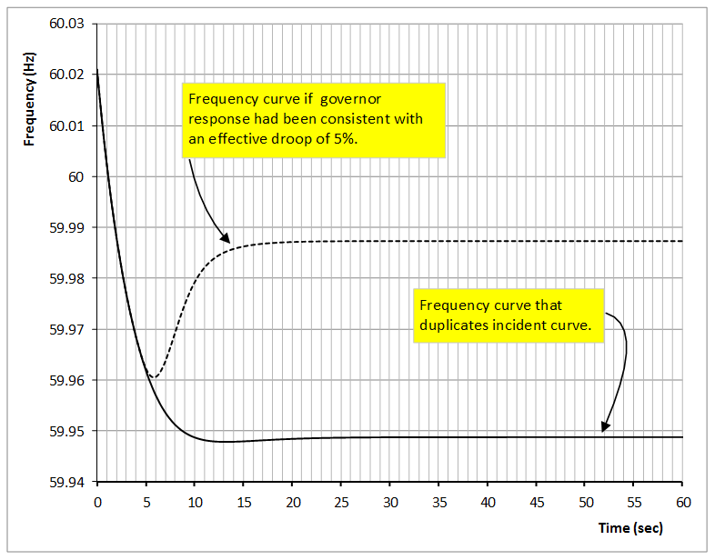
Figure 4 – What If governor response had been consistent with a 5% Droop. In such case the frequency would have recovered to 59.987 Hz. This highlights the critical importance of adequate governor response.

Slide 9
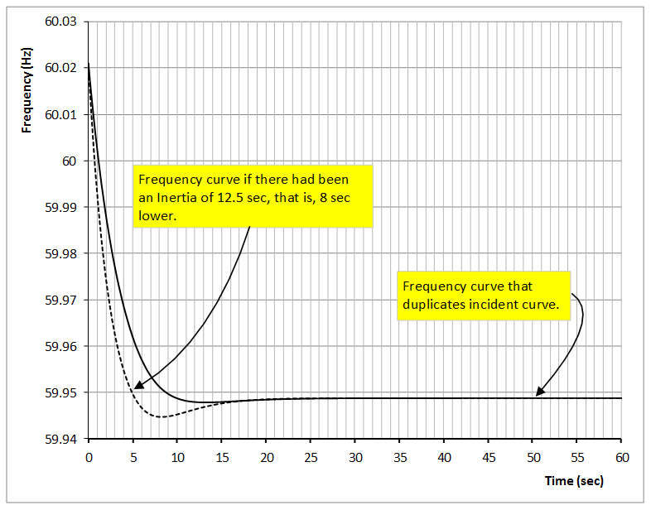
Figure 5 – What If there had been an Inertia of 12.5 sec, namely, 8 sec lower. As expected the frequency would have reached a lower value before the arrival of governor response. However the the ultimate frequency would have been the same as before.

Slide 10
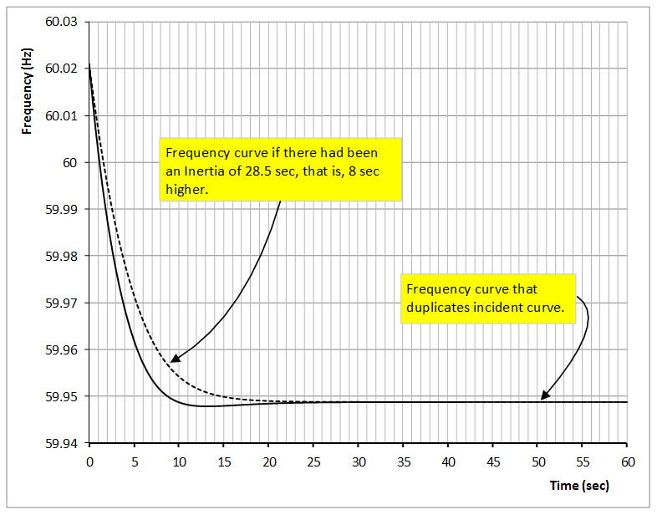
Figure 6 – What If there had been an Inertia of 28.5 sec, namely 8 sec higher. As expected the frequency decays at a lower rate and the frequency is higher when governor response arrives. Also as expected, the value of the frequency at which the decay is arrested is the same as before.

Slide 11
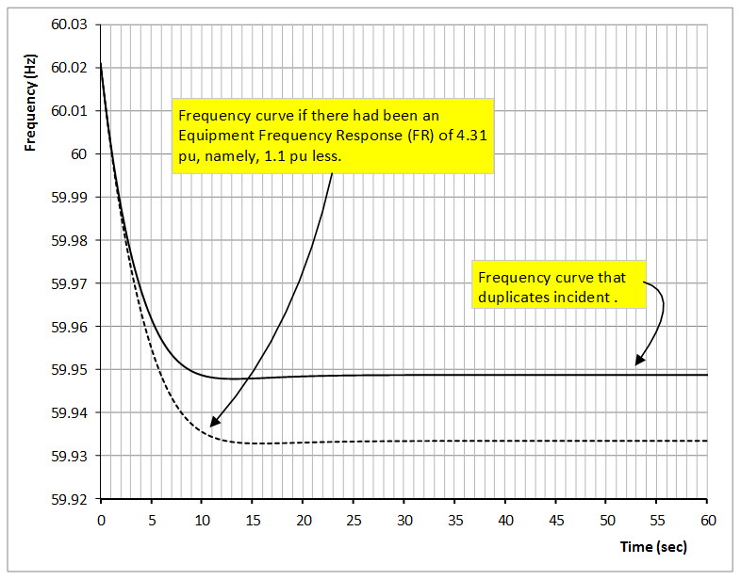
Figure 7 – What If the Equipment FR had been lower. It is of interest to note that a lower Equipment FR impacts the frequency decay rate of change in a way similar to a lower Inertia. However a lower Equipment FR also lowers the ultimate frequency that the system would attain. This highlights the importance of Equipment FR.

Slide 12
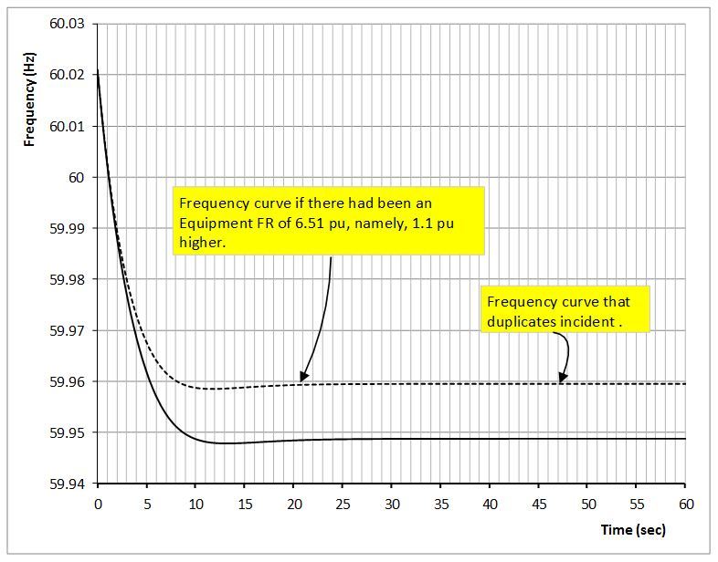
Figure 8 – What If there had been a higher Equipment FR, namely 1.1 pu higher. It is of interest to note that a higher Equipment FR impacts the frequency decay rate of change in a way similar to a higher Inertia. However a higher Equipment FR increases the ultimate frequency that the system would attain.

Slide 13
The M and H Inertia Constants
The Inertia constant H is defined as the kinetic energy (KE) stored in the machine rotating mass at rated speed in per unit (pu) of the machine power rating as follows:
(1)
Let the machine rating be :
Also, the kinetic energy is given by the formula where I is the
Moment of Inertia, M is the Angular Momentum and is the angular speed. Accordingly H can be written as:
and rearranging (2)
Since the H and M constants are calculated at rated speed, . Therefore
from equation (2) the following relationship is obtained in which M is in pu of rated torque.
pu (3)

Slide 14
Dimension of the Per Unit Values of H and M
From the previous slide
Where the bar over M is to signify pu value.
Therefore, when expressed in pu of the noted bases (machine rating for H, base torque for M, rated angular speed for ), M and H have the dimension of seconds.

